Slide 1
Miracles
Prepared by the Ian Ramsey Centre

Slide 2
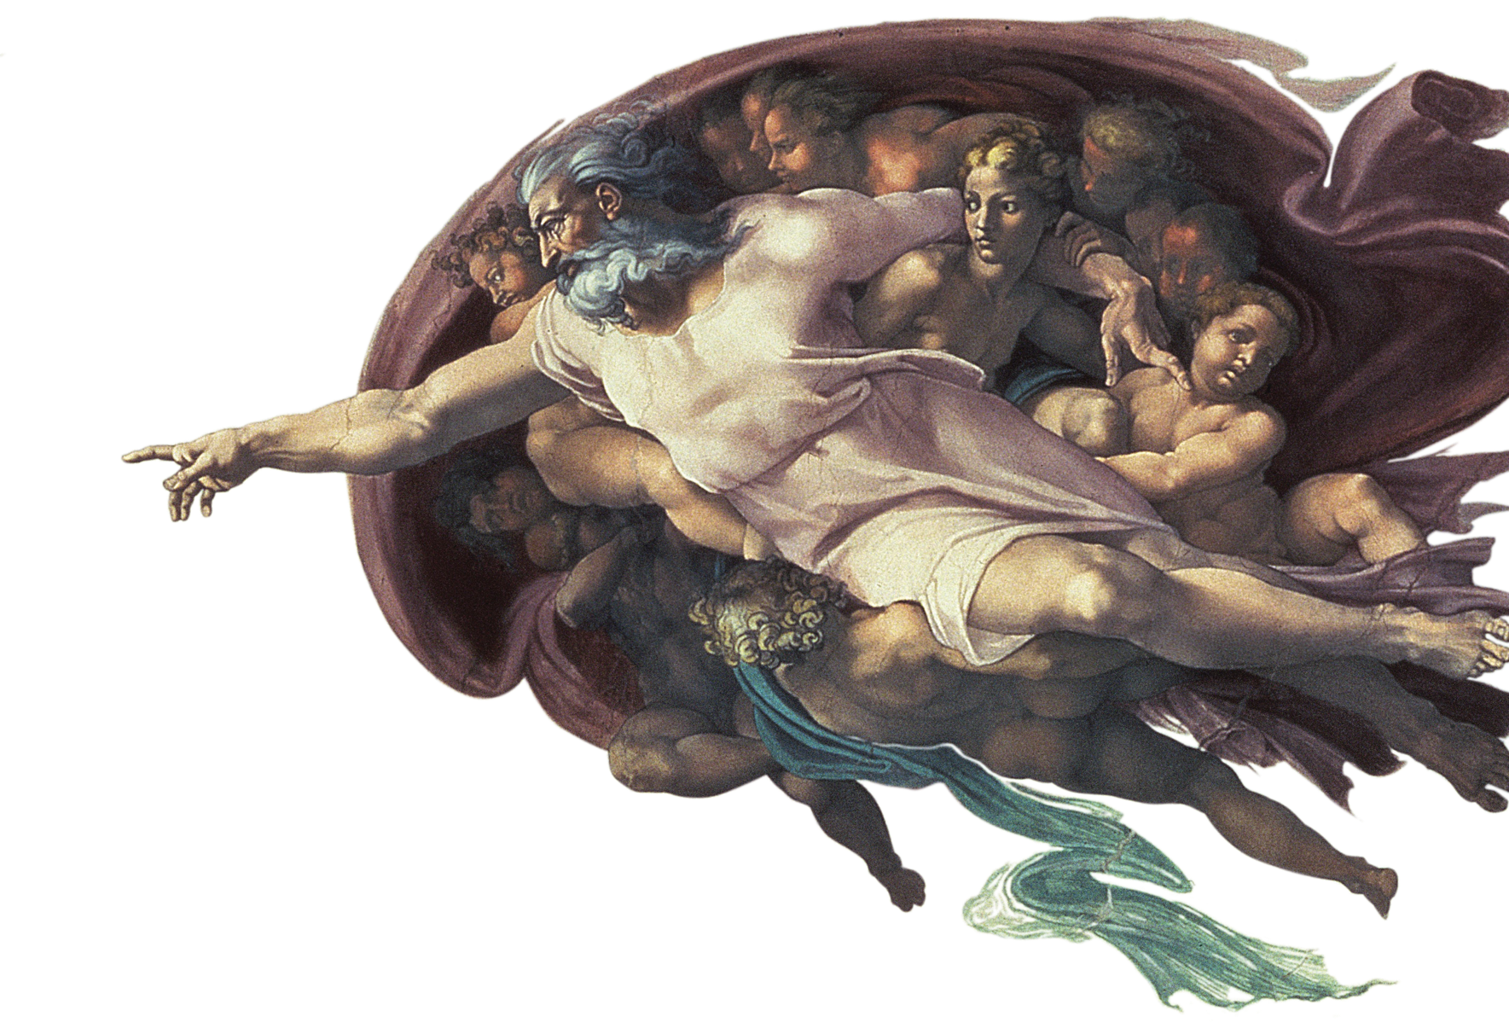
What is a ‘miracle’?
Reports of miracles
Objections and responses
Concluding remarks

Slide 3
What is a miracle?

Slide 4
The origin of the word ‘miracle’
The root of the term ‘miracle’ in classical Latin is miraculum, meaning “an object of wonder.”
Events that are classified as miracles also tend to be objects of wonder, but not all objects of wonder are miracles.

Slide 5
What is a ‘miracle’ (I)?
St Thomas Aquinas defined a miracle as follows:
“Things that are at times divinely accomplished, apart from the generally established order in things, are customarily called miracles (miracula); for we admire with some astonishment a certain event when we observe the effect but do not know its cause. And since one and the same cause is at times known to some people and unknown to others, the result is that of several who see an effect at the same time, some are moved to admiring astonishment, while others are not. For instance, the astronomer is not astonished when he sees an eclipse of the sun, for he knows its cause, but the person who is ignorant of this science must be amazed, for he ignores the cause. And so, a certain event is wondrous to one person, but not so to another ...”
Aquinas, Summa Contra Gentiles 3.101, trans. V. J. Bourke

Slide 6
What is a ‘miracle’ (I)?
St Thomas Aquinas defined a miracle as follows:
“… So, a thing that has a completely hidden cause is wondrous in an unqualified way, and this the name, miracle, suggests; namely, what is of itself filled with admirable wonder, not simply in relation to one person or another. Now, absolutely speaking, the cause hidden from every man is God. In fact, we proved above that no man in the present state of life can grasp His essence intellectually. Therefore, those things must properly be called miraculous which are done by divine power apart from the order generally followed in things ...”
Aquinas, Summa Contra Gentiles 3.101, trans. V. J. Bourke

Slide 7
What is a ‘miracle’ (I)?
St Thomas Aquinas’s definition is technically precise, but it is not always easy to identify the correct causes of events, let alone to exclude all possible natural causes.
Given also that we prefer to restrict ‘miracles’ to dramatic events that provoke wonder, exceeding the productive power of nature, a version of Aquinas’s definition that is slightly less precise but easier to use is: an event that exceeds the productive power of nature
By excluding all possible natural causation, the cause of a miracle is normally attributed directly to God.

Slide 8
Aquinas: categories of miracles
The highest category of the miraculous are events in which something is done by God that nature never could do. The more these things are removed from the capacity of nature, the greater the miracle is, “Thus, it is more miraculous for the sun to reverse its course than for the sea to be divided.”
The second degree among miracles is held by those events in which God does something which nature can do, but not in this order, e.g. for an animal to live after death, to see after becoming blind, to walk after paralysis of the limbs.
The third degree of miracles occurs when God does what is usually done by the working of nature, but without the operation of the principles of nature. For example, a person may be cured by divine power from a fever which could be cured naturally.

Slide 9
A stable background
As Aquinas’s classifications suggests, a miracle is an event that exceeds the productive power of nature. This productive power of nature is the stable background against which what is ‘miraculous’ and hence not of nature can be contrasted.
“… An experienced uniformity in the course of nature hath been always thought necessary to the belief and use of miracles. These are indeed relative ideas. There must be an ordinary regular course of nature, before there can be any thing extraordinary. A river must flow, before its stream can be interrupted...”
William Adams (1767: 15)
Hence recognition of a miracle implies a prior recognition of regular, natural order. If we see the world as a disconnected flow of events, then everything (and nothing) is a ‘miracle’.

Slide 10
A stable background
This need for contrast between what ordinarily happens and the miraculous also implies the need to distinguish between natural causation and divine intervention.
This requirement also implies a conception of the world in which there is such a thing as natural causation. From a theist standpoint, this perspective in one in which “God has given his creatures the dignity of being causes.” (Aquinas, Summa Theologiae [ST], I, q. 22, a. 3).
To underline this point, imagine a world in which everything that happens was caused immediately by God directly: everything would be a miracle, and so nothing would be a miracle.

Slide 11
Other definitions of a ‘miracle’
David Hume (Hume 1748/2000; cf. Voltaire 1764/1901: 272) defined a miracle as “a violation of the laws of nature,” a narrower definition than “exceeding the productive power of nature.” This definition is influential but there are problems:
“If the natural laws are simply compendious statements of natural regularities, an apparent ‘violation’ would most naturally be an indication, not that a supernatural intervention in the course of nature had occurred, but rather that what we had thought was a natural law was, in fact, not one” (McGrew 2011).
In many cases it is difficult to say which ‘laws’ are being violated by the event in question (Earman 2000), “That dead men stay dead is a widely observed fact, but it is not, in the ordinary scientific use of the term, a law of nature that dead men stay dead” (McGrew 2011).

Slide 12
Theological and religious considerations
Unlike ‘magic’, the term ‘miracle’ is generally taken to involve some personal recognition of a supra-natural event as being caused by a personal God, or possibly some other Intelligent Agent superior to man [cf. Samuel Clarke (1719: 311–12)].
For palpable religious significance, miracles normally also advance or confirm religious knowledge and promote human action that would otherwise be unlikely to happen.
SUMMARY: A miracle exceeds the productive power of nature. A religiously significant miracle is a detectable miracle attributed to a (personal) divine cause.

Slide 13
Reports of miracles

Slide 14
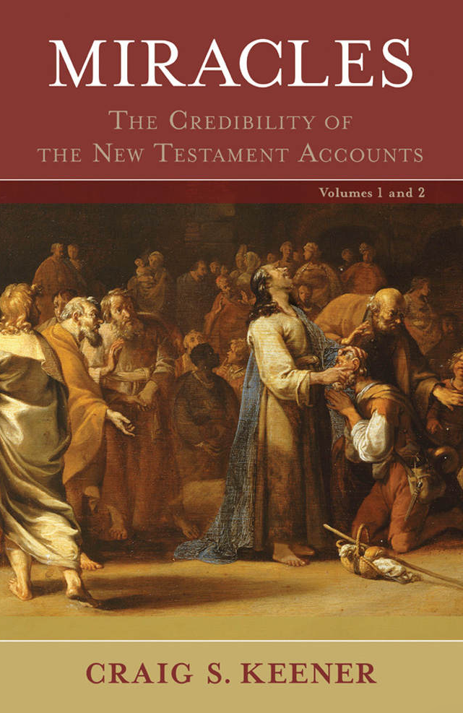
How common are reports of miracles?
Craig Keener, Miracles, published in 2011, drew from extensive primary research on this question from all parts of the world.
One fact emerges. The topic is not merely a theoretical one today. Whether such reports can be trusted or not, hundreds of millions of people today claim to have experienced miracles.

Slide 15
Special cases: the Catholic perspective
The Catholic Church has a strong interest in miracles for several reasons. One reason is that reported miracles associated with the prayers of a saint are one of the signs that this person is definitely a saint in heaven with God.
The Church has developed a systematic and documented approach to appraisal of miracles, especially medical cures.
The assessment cannot directly prove that a miracle has taken place. On the contrary, all possible and reasonable natural explanations are examined. If no such reason can be found, the cure may be declared to be worthy of belief as a miracle.

Slide 16
Special cases: Lourdes
For cures at Lourdes, a famous shrine in France associated with miracles, the four criteria are:
the fact and the diagnosis of the illness is first of all established and correctly diagnosed;
the prognosis must be permanent or terminal in the short term;
the cure is immediate, without convalescence, complete and lasting;
the prescribed treatment could not be attributed to the cause of this cure or be an aid to it.
The Church has officially recognized 67 miracles and some 7,000 inexplicable cures since the apparitions of Feb 1858.

Slide 17
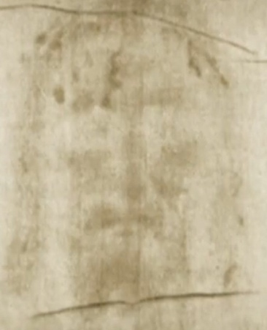
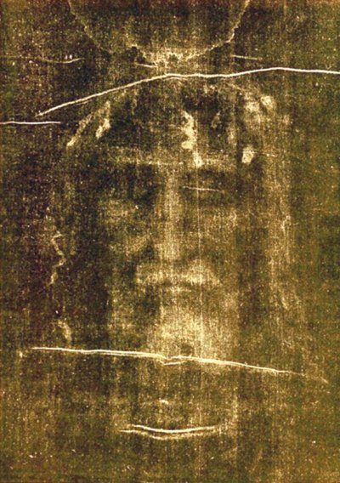
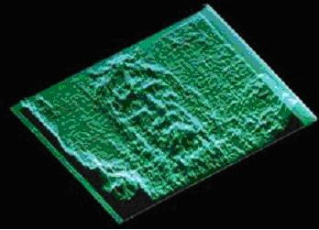
Special cases: physics of the Turin Shroud, the most studied artefact in the world
This image of the front and back of a crucified man, honoured as an icon and relic of Jesus Christ, is made up of millions of tiny spots. It is a pixilated image, unlike continuous painted images; the spots are only two microns thick, and are only on the outermost fibres. The image is not made from organic paints and has survived fire and water, showing that it is insoluble.
The shroud is a negative so that the positive image was only seen with the invention of photography. The shape of the body can be recovered in part from its 3D information.
Carbon testing in 1988 implied a date of origin between 1260 to 1390, but controversy continues to the present day about the possibility of contaminants and the source area from which the samples were taken. Former Nature editor Philip Ball, “… despite the seemingly definitive tests in 1988, the status of the Shroud of Turin is murkier than ever. Not least, the nature of the image and how it was fixed on the cloth remain deeply puzzling.”

Slide 18
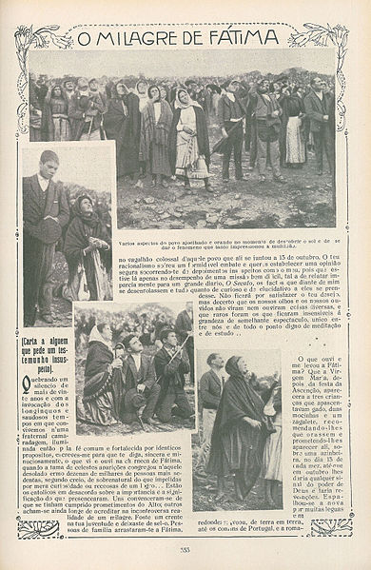
Special cases: the ‘Miracle of the Sun’
The Miracle of the Sun (Portuguese: O Milagre do Sol) was an event which occurred on 13 October 1917, attended by 30,000 to 100,000 people gathered near Fátima, Portugal. The event was attributed by believers to Our Lady of Fátima, a reported apparition of the Blessed Virgin Mary. The children stated that the Lady had promised them that she would on 13 Oct reveal her identity and provide a miracle “so that all may believe.”
According to many witnesses (some over 10 miles away), after a period of rain, the dark clouds broke and "the sun" appeared as an opaque, spinning disc in the sky. It was said to be significantly duller than normal, and to cast multi-colored lights across the landscape, the shadows on the landscape, the people, and the surrounding clouds. The sun was then reported to have careened towards the earth in a zigzag pattern, frightening those who thought it a sign of the end of the world.
"The sun's disc did not remain immobile. This was not the sparkling of a heavenly body, for it spun round on itself in a mad whirl, when suddenly a clamor was heard from all the people. The sun, whirling, seemed to loosen itself from the firmament and advance threateningly upon the earth as if to crush us with its huge fiery weight. The sensation during those moments was terrible." Dr. Almeida Garrett, Professor of Natural Sciences at Coimbra University.

Slide 19
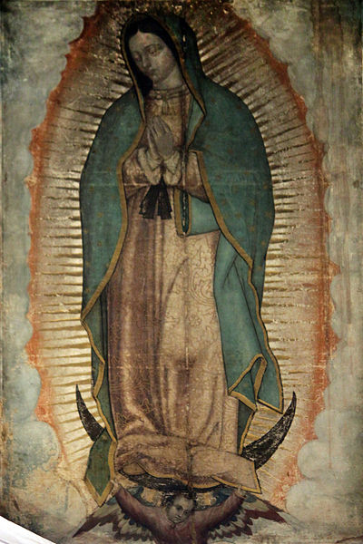
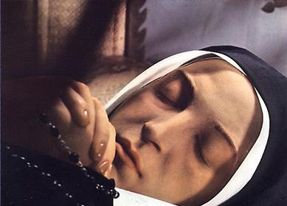
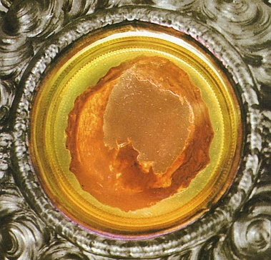
Special cases: holy persons or objects
Eucharistic miracles, in which hosts preserved serendipitously do not decay (Siena, 1730), or from which flesh and blood appear (Lanciano, c. 700). The most recent tests on the flesh and blood of Lanciano were carried out in 1971 by Odoardo Linoli, a professor in anatomy and pathological histology as well as chemistry and clinical microscopy. The tissue is real cardiac tissue and the blood has the protein-composition of fresh, normal AB blood, cf. "Quaderni Sclavo di Diagnostica Clinica e di Laboratori" (1971).
Normally within a year all that is left of a body buried in a coffin is the skeleton and teeth, with traces of the tissues on them. St Bernadette Sourbirous was exhumed three times after her death from illness in 1879 and burial in damp conditions. Dr Comte, who examined the body, wrote "What struck me during this examination, of course, was the state of perfect preservation of the skeleton, the fibrous tissues of the muscles (still supple and firm), of the ligaments, and of the skin, and above all the totally unexpected state of the liver after 46 years.” The body remains on view in the Chapel of Nevers Convent.
Our Lady of Guadalupe (1531), patroness of the Americas, reputed to be a image that appeared miraculously on the cloak (tilma) of a peasant, St. Juan Diego Cuauhtlatoatzin, as a sign for him to show to the Archbishop.

Slide 20
Objections and responses to miracles

Slide 21
Can miracles, or even plausible candidates for miracles, happen at all? (I)
Objection. Some argue that the ‘world’ (the totality of all that is) excludes miracles in principle, i.e. that all causation is natural causation. For example, perhaps the laws of physics cannot be broken, or perhaps the will of God is identical with the laws of nature, so that God cannot intervene without contradicting himself (cf. Spinoza [1670/1862: 123, 128]).
Response. Such arguments are only valid if the world is the way portrayed in the premises, which is an assumption. The notion that God’s intervention implies original imperfection in creation ignores the possibility of creatures, granted the dignity of being causes, themselves introducing imperfections, the remedies for which imply the need for divine intervention.

Slide 22
Can miracles, or even plausible candidates for miracles, happen at all? (II)
Objection. A slightly more subtle argument against miracles is that “exceeding the productive power of nature” assumes that the scope of the productive power of nature is known, but this is not always the case. As Aquinas noted, an eclipse might appear miraculous to someone who is not an astronomer. So rather than an intervention by God, a miracle might be the effect of some natural cause that is currently unknown.
Response. When extraordinary but naturally-caused events are excluded, there are still plenty of candidate events (e.g. multiplying loaves and fish, walking on water, and rising from the dead days after crucifixion) that would, if true, be generally acknowledged as unattributable to natural causes …

Slide 23
Can miracles, or even plausible candidates for miracles, be rationally believed?
Objection. There are many attested miracles, but should these testimonies be believed? Most of the arguments against belief in such testimonies today are variations on the work of David Hume, who claimed that “… no testimony is sufficient to establish a miracle, unless the testimony be of such a kind, that its falsehood would be more miraculous, than the fact, which it endeavours to establish.”
Response. Objections to Hume’s maxim and similar arguments focus on highlighting their hidden circularities, e.g. that the case against belief in miracles rests upon the claim that laws of nature are supported by exceptionless testimony, but testimony can only be accounted exceptionless if we discount the occurrence of miracles (Campbell, 1762).

Slide 24
A theological objection to miracles (I)
Objection. St John Henry Newman argued that scripture shows that miracles are not a remedy for unbelief. Nor do miracles actually make a person morally better, or remove hardened hearts, or develop habits of religion. http://www.newmanreader.org/works/parochial/volume8/sermon6.html
Response. Newman argues convincingly, but one should not conclude that there is no role for miracles at all. In the history of the Jewish and Christian people, for example, miracles were reported and played significant roles at many particular times. In particular, miracles were one of the most characteristic features of the ministry of Jesus Christ. They can often “kick start” new initiatives or may play a role in confirming beliefs.

Slide 25
A theological objection to miracles (II)
Objection. If God can intervene miraculously to correct certain evils, for example by curing people from physical sicknesses, why does God not intervene consistently?
Response. This challenge is a special case of the ”problem of evil”, which hinges on the question of whether or not there are any morally justifiable reasons for an omnipotent, omniscient and perfectly good God to permit suffering. Two ways to start to address this issue are to begin by asking what does a good God desire to bring about, and whether divine interventions in response to every prayer would help bring about this goal.

Slide 26
From miracles to grace? (I)
Over the history of Christianity, the supernatural effects of purported miracles at certain times have often foreshadowed natural works later by inspired persons living graced lives.
For example, scripture (Acts 2:1-11) reports that the Holy Spirit gave the apostles the power of being understood by native speakers of many of the language groups gathered in Jerusalem for the feast of Pentecost.
This event foreshadowed an enormous range of continuing linguistic work by the Church, including fixing the forms of languages (e.g. Armenian), inventing alphabets (e.g. Cyrillic) and scripts (e.g. Gothic), writing languages down (e.g. Turkana), founding grammar schools, and shaping many languages, such as English, French, Italian, Portuguese, and Spanish.

Slide 27
From miracles to grace? (II)
Over the history of Christianity, the supernatural effects of purported miracles at certain times have often foreshadowed natural works later by inspired persons living graced lives.
For example, scripture reports many works of miraculous healing by Jesus Christ and his early followers.
These healings foreshadowed an enormous contribution to health care by the Church, including founding hospitals in the late Roman Empire, throughout the Middle Ages, and into modern times. Christian civilisation also produced the first medical school (Salerno), discovered capillary action (Malpighi), and founded the Royal College of Physicians. Until recently, senior nurses were still called “sister”, a title reflecting the largely religious origin of the practice of nursing.

Slide 28
Conclusions

Slide 29
Concluding remarks
A miracle exceeds the productive power of nature (Aquinas); or is “a violation of the laws of nature” (Hume).
A religiously significant miracle is a detectable miracle attributed to a (personal) divine cause.
Whether or not miracles actually violate laws of nature depends on the meaning and applicability of such laws. Insofar as laws of nature describe systems that are isolated from external interference they are not relevant to the question of miracles.
If they happen, miracles are rare, almost by definition. In Judeo-Christian history, they are associated principally with new initiatives in individual or collective experience.

Slide 30
Further reading and viewing
Short videos
3-minute video by the Ian Ramsey Centre: https://www.youtube.com/watch?v=MRFSnBM2OBQ
1-minute cartoon by the Ian Ramsey Centre, “Albert Explores”: https://www.youtube.com/watch?v=lRrr1JLV1JM
Bibliography
Aquinas, St. Thomas, Summa Contra Gentiles (SCG), [Available online, translation by J. Rickaby, London: Burns and Oates, 1905].
–––, Summa Theologiae (ST), [Available online, translated by the Fathers of the English Dominican Province].
Adams, William, 1767, An Essay in Answer to Mr. Hume’s Essay on Miracles, 3rd ed., London: B. White.
Campbell, George, 1762, A Dissertation on Miracles, London: Thomas Tegg, 1839.
Earman, John, 2000, Hume’s Abject Failure, Oxford: Oxford University Press.
Hume, David, 1748 et seq., An Enquiry Concerning Human Understanding, Tom L. Beauchamp (ed.), New York: Oxford University Press, 2000.
McGrew, Timothy, "Miracles", The Stanford Encyclopedia of Philosophy (Spring 2019 Edition), Edward N. Zalta (ed.), URL = <https://plato.stanford.edu/archives/spr2019/entries/miracles/>.

Slide 31
The Resurrection of Jesus Christ: the founding miracle of Christianity
The Resurrection by Piero della Francesca

Slide 32
This publication was made possible through the support of a grant from Templeton World Charity Foundation, Inc. The opinions expressed in this publication are those of the authors and do not necessarily reflect the views of Templeton World Charity Foundation, Inc.

