Slide 1
The problem of evil and suffering
Prepared by the Ian Ramsey Centre

Slide 2
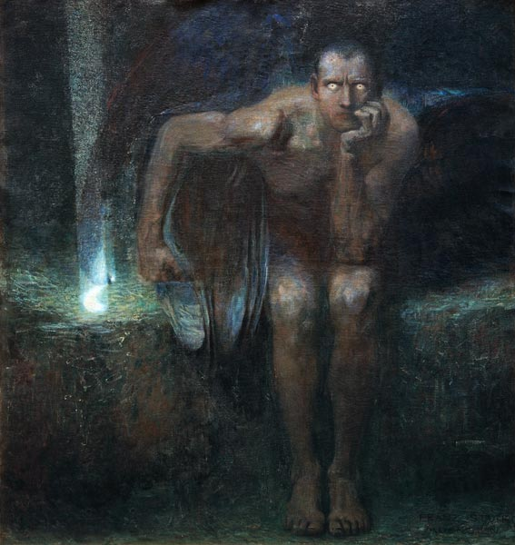
What is evil?
The problems and resolution of evil
Concluding remarks
”Lucifer” (1890) by Franz Stuck Source: public domain; Wikimedia commons

Slide 3
What is evil?

Slide 4
Defining ‘evil’
What is evil? The meaning of the word is generally learnt by examples, especially stories about the most malevolent, malicious, and vile people in history, myth, or fiction.
There is also a fairly consistent iconography of evil. The standard symbols include, for example, darkness and beasts associated with the perversion, corruption, and death of other living beings. Hence evil was and still is associated with snakes, dragons, parasites, vultures, vampire bats, flies, and maggots.
This iconography is only fairly consistent since it is the nature of evil to deceive. The name Lucifer, for example, associated with the most powerful evil being, literally means “light bearer.”

Slide 5
Natural metaphors for ‘evil’
Source: Bigstock ID: 302839825 Copyright: Trassnick
The carnivorous angler fish, which carries a light to lure prey close to its jaws.
Why might this fish be suitable as an image (metaphor) for some kinds of evil?

Slide 6
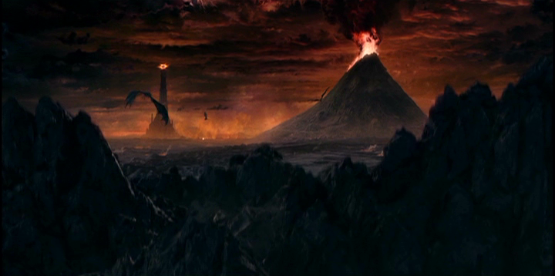
Describing ‘evil’ through stories: Tolkien’s Mordor and Dante’s Inferno
Through the great ward we entered unopposed, And I, being all agog to learn what state Of things these huge defensive works enclosed,
Gazed round, the moment I had passed the gate, And saw a plain, stretched spacious on both sides, Filled with ill woes and torments desolate.
Dante, The Inferno, Canto IX, The City of Dis
(trans. Dorothy Sayers)
Source: Public access still from The Two Towers, directed by Peter Jackson © New Line Productions

Slide 7
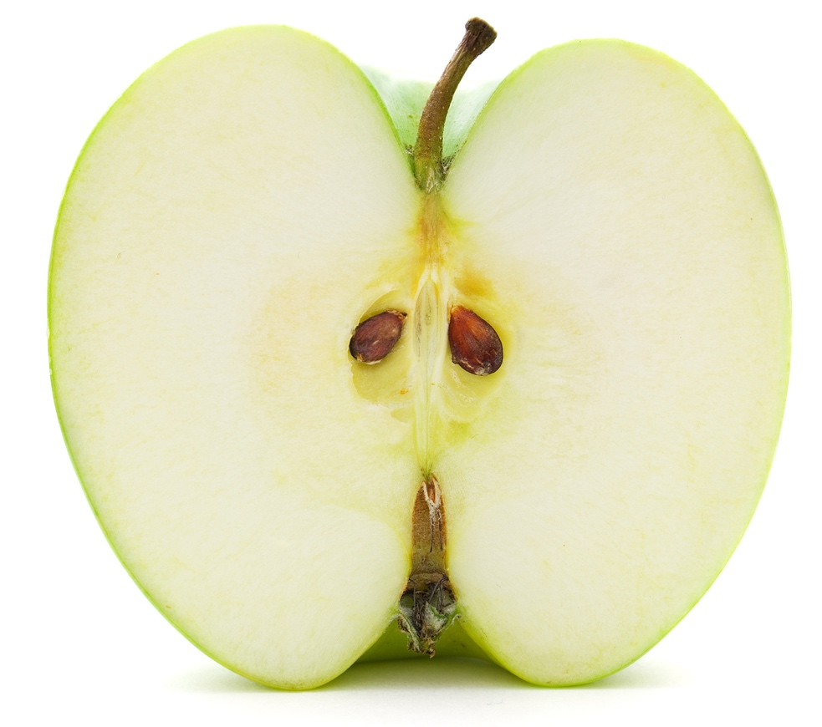
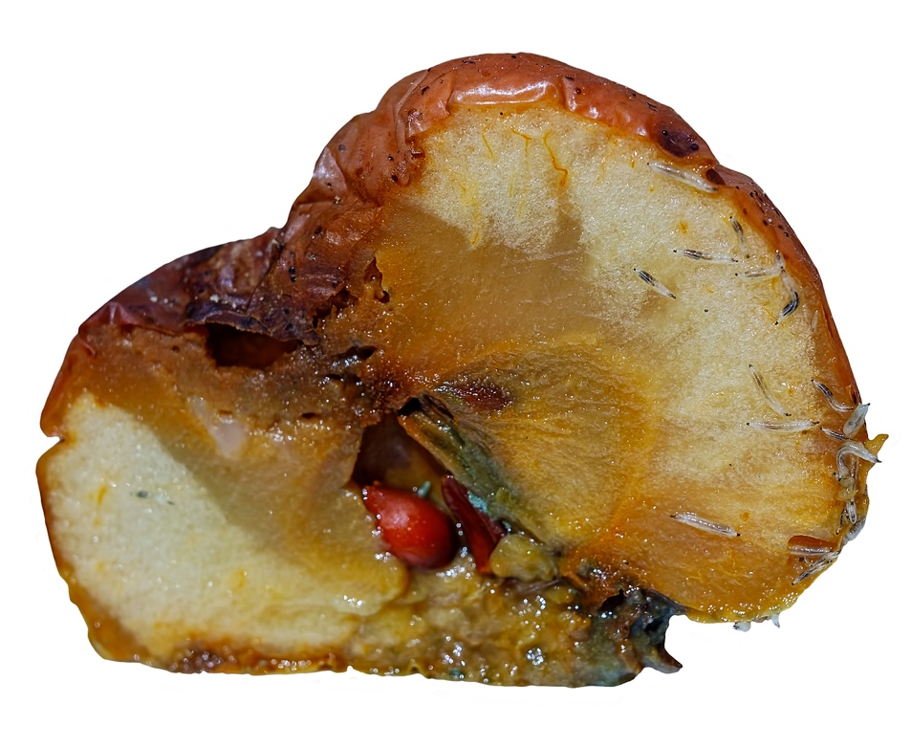
Evil as a corruption of what is good: a wholesome and rotten apple
Source: Bigstock 12353204 and 240733075 Copyright: Alex Staroseltsev and Roberto Sorin

Slide 8
Lessons from the rotten apple
What makes the rotten apple bad is that it is a decayed and corrupted version of a wholesome apple. The lesson is that evil is defined relative to goodness.
But the opposite is not true. The goodness of a good apple is defined principally by its correspondence to the mature or fully developed natural form of the apple.
Note, however, that anything, whether good or bad with respect to its own nature, can still be an instrumental good or evil, in other words good or bad for something or someone. For example, a good apple is good for us to eat, but a bad apple, which is bad for us to eat, may be good for a maggot to eat.

Slide 9
Defining ‘evil’
St Augustine of Hippo (d. 430 AD) followed a similar approach in his philosophy of evil. His answer to the question, “What is evil?” is a deprivation or perversion of what is good.
On this account, ‘good’ and ‘evil’ are not equal and opposite, like matter and antimatter (which was the position of Augustine’s opponents, the Manicheans).
Instead, on Augustine’s view, evil is parasitical upon good, and accounts of evil have to refer to what is good. By contrast, neither goodness nor its description need refer to evil at all.

Slide 10
Defining ‘good’ and ‘evil’
GOOD | EVIL
Principally, therefore, a being capable of perfecting another after the manner of an end is called good. | Evil has no positive nature; but the loss of good has received the name ‘evil’.
St Thomas Aquinas, On Truth (De Veritate), q. 21, a. 1 c. | Augustine, The City of God, XI.9.

Slide 11
A tension: natural and moral evil
The angler fish and the rotten apple may, however, raise a question. They may be effective images or metaphors for evil, but predators and rottenness are part of the natural world.
A distinction is needed. There are natural things that detract from the flourishing of at least some beings, and that we often find abhorrent or repellent. Such things are called natural evils. There are also evils arising from the perverted choices of rational beings, which are called moral evils.
Natural evils are often used as metaphors for moral evils, especially as choices are not visible in themselves. But natural evils can also be instrumental goods. For example, a world without predation or decay would have serious problems.

Slide 12
Eliminating natural evils? Not so easy
The Oostvaardersplassen scheme to ‘rewild’ an area of the Netherlands, but only with plant-eating herbivores, has led to a population explosion, vast numbers of sickly and starving animals, and a decline of trees and wild birds.
Source: Bigstock 37595734. Copyright: kruwt

Slide 13
Are natural and moral evils connected?
Natural evils are the most apparent and easiest to understand, but moral evils, or more specifically beings capable of choice who act in characteristically evil ways, are much closer to the usual understanding of what is meant by ‘evil’.
Many natural evils are often a consequence of moral evils. For example, an evil action may typically involve both natural evil, in the sense of the harm done to someone, and involve moral evil in the sense of someone else choosing to do that harm.
As noted previously, natural evils are often used as images and metaphors for moral evils. For example, sickness is a natural evil for human beings, but someone who is morally corrupt might be described metaphorically as ‘sick’.

Slide 14
Degrees and kinds of evil?
Moral evils, or more specifically morally evil beings who act in characteristically evil ways, are much closer to the general understanding of what is meant by ‘evil’.
Since beings are very varied, there is a great diversity of natural evils. There is also a great diversity of moral evils, in terms of kinds, degrees, and culpability.
Consider, for example, lying. As a wrong action, its description is relatively simple, namely speaking falsely, in other words stating something false with an intention to deceive. There is, however, a vast moral difference between, for example, lying to avoid hurting someone’s feelings and lying to convict a friend, betraying that friend to torture and death.

Slide 15
Lying: a wide range of seriousness St Thomas Aquinas on lying divided according to motive
INCREASED SERIOUSNESS OF EVIL
Help someone’s soul
Officious Intention of usefulness to another
Help someone’s life
Help someone’s goods
Jocose Intention to please
Intention to please
LYING
Habitual Intention of lying
Intention of lying
Combined injury and profit
Malicious Intention of injury
Injury against human persons
Injury against God

Slide 16
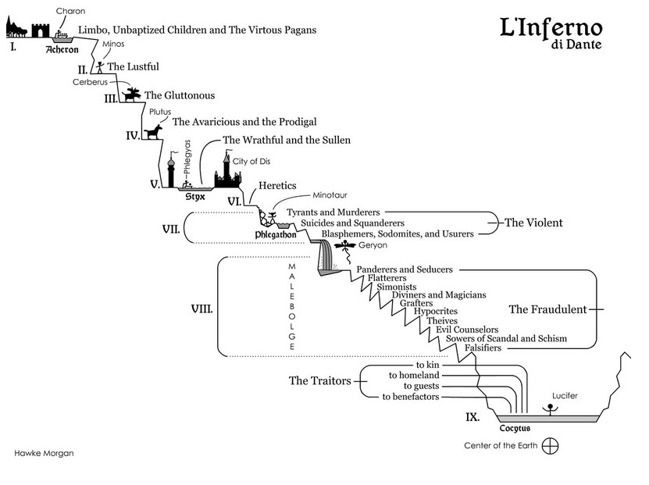
Dante’s Inferno: a map of moral evils and their relative seriousness as perceived in 1320 AD

Slide 17
Is evil also a force?
Evil can sometimes appear to be a force, with intellect and will. Deeply evil people can appear to personify this force.
Many religions also believe that there are spiritual created beings who act in the world. Among these beings, called angels, some have made a single and irrevocable choice for evil. These evil angels are called demons, whose principal efforts are directed towards the damnation of human souls.
Both good and evil angels form societies and have ranks. In Catholicism, three good angels are mentioned by name: the Archangels Gabriel, Michael, and Raphael. The most powerful evil angel is the Devil, Satan, or Lucifer. Scripture depicts war between angels and demons (Revelation 12:7-10).

Slide 18
Source: Public domain, with enhancement by the Google Art Project

Slide 19
The situation of evil today
Evils of one kind or another have traditionally been the greatest problems facing us. In cases in which evils are instrumental goods, a common strategy has been to minimize the evils while trying to retain instrumental effects, e.g. local anaesthetics.
Globally, a great deal has been achieved to reduce natural evils. Life expectancy worldwide has doubled since the beginning of the Industrial Revolution and associated advances in healthcare. The use of artificial power has also radically reduced the direct human effort required to produce our food or necessities of life, undermining the economic basis of slavery.
On the other hand, the moral picture is mixed, and technically advanced societies have also proved capable of terrible evil.

Slide 20
What is NOT the problem of evil?
Suffering involves physical or mental pain but not all suffering is unwanted. For example, some desired goals are difficult to attain and are chosen despite the suffering involved.
Anyone training to compete in the Olympics, for example, chooses freely to suffer extensively and for long periods. Similarly, Michelangelo suffered so much while painting the Sistine Chapel ceiling that he wrote a poem about the suffering. As another example, Christians in the early Church expected the path to salvation to involve suffering. As a result, they sometimes worried about not suffering enough.
The lesson is that we do not really have an intellectual problem with suffering as means to some chosen good goal.

Slide 21
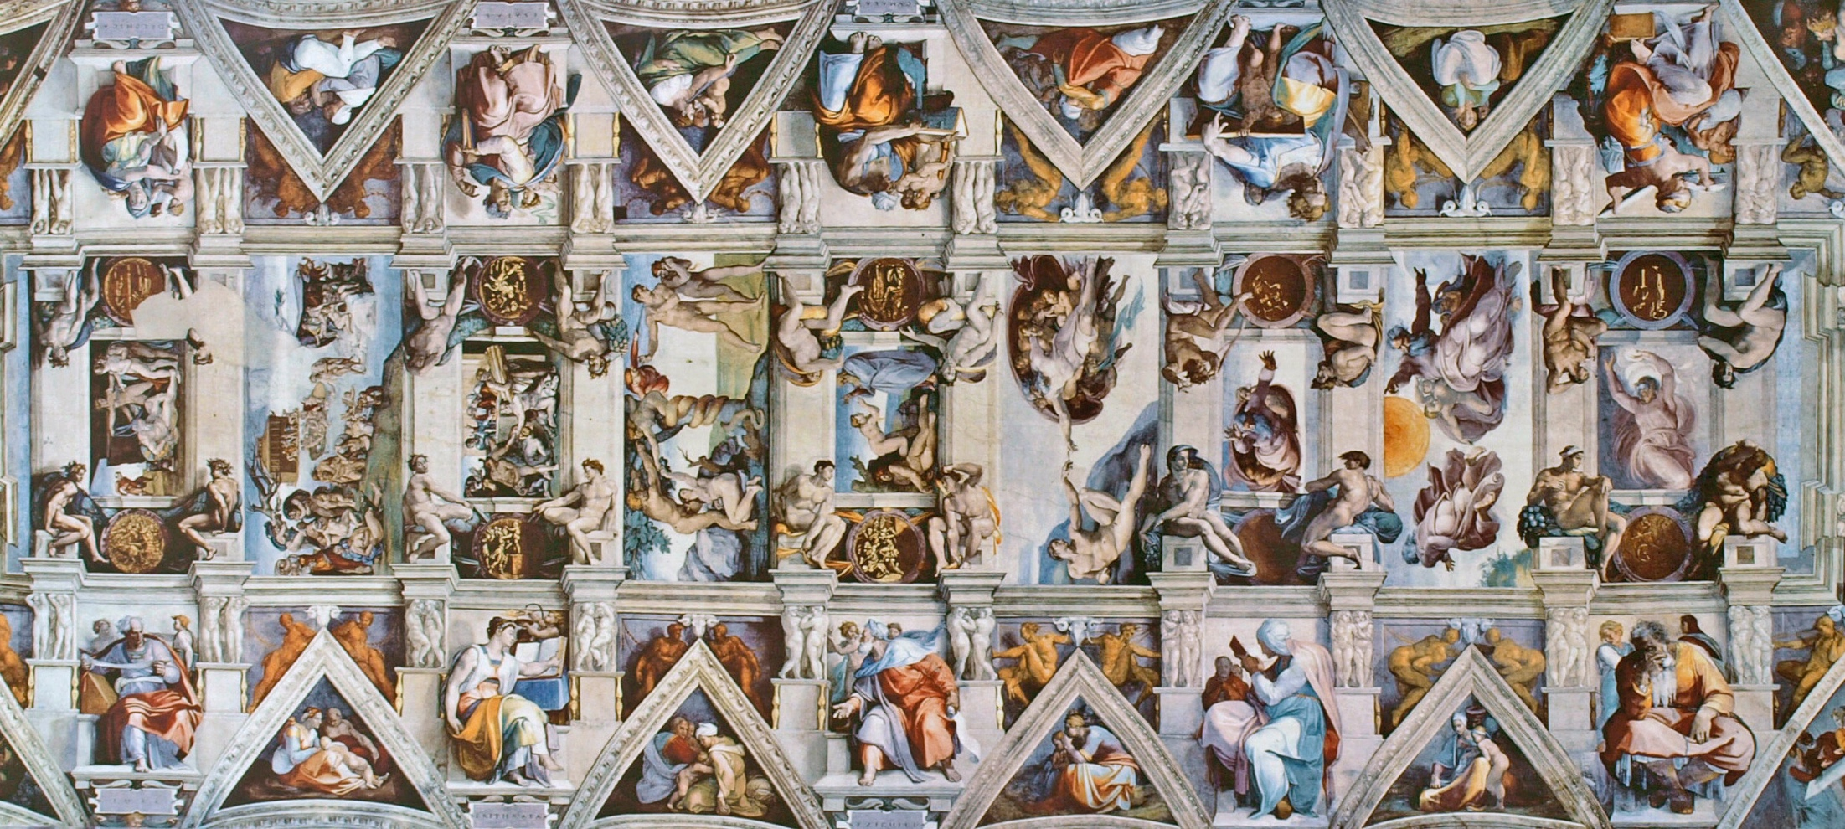
Most of the Sistine Chapel Ceiling: a fruit of years of excruciating work
Source: CC BY-SA 3.0, https://commons.wikimedia.org/w/index.php? curid=27931331

Slide 22
What are the genuine problems of evil?
Confronted by evil, what should we do about it? We can reduce some natural evils but we cannot remove them utterly, and we ultimately face personal death and eventual cosmic death.
For any worldview that includes the existence of a personal Creator God, other crucial questions include:
(a) How did evil start? and
(b) Given that it has arisen, why hasn’t it been stopped?
These problems are subtle and, at least in part, moral evils turn out to be interconnected with natural evils in various ways. The remainder of this presentation considers these problems and various attempts at their resolution in more detail.

Slide 23
The problems and resolution of evil

Slide 24
The inconsistent triad
Consider these three statements:
There is an all-knowing, all-powerful, perfectly good God.
There is evil in the world.
There is no morally sufficient reason for an all-knowing, all-powerful, perfectly good God to permit evil in the world.
One of these statements must be false, and most would accept that (2) is true. So either (1) or (3) is true, but not both. So the question of whether or not there is a morally sufficient reason for evil is also a question about God’s existence and nature.
The classical philosophical Epicurus (4C-3C BC), David Hume, Dialogues Concerning Natural Religion, and J. L. Mackie, The Miracle of Theism, defended (3) to deny the existence of God.

Slide 25
The best of all possible worlds?
Gottfried Leibniz (d. 1716) coined the term theodicy, which Alvin Plantinga defined as an “answer to the question of why God permits evil” (God, Freedom, and Evil, p.10). The frame-work of a theodicy reconciles the existence of God and evil.
Leibniz’s own theodicy made all evils unavoidable in the world as it is, a world that Leibniz described as “the best of all possible worlds.” On this account, all evils are instrumental goods insofar as any alternative kinds, numbers, and arrangements of evils in the world would be worse overall.
VERDICT. This view was widely ridiculed, famously by Voltaire (d. 1778) in Candide, following the Lisbon earthquake, and is not popular today. Nevertheless, Leibniz drew attention to the interconnectedness of goods and evils. For example, as noted previously, herbivores do not live well without predators.

Slide 26
Freedom as a prerequisite of evil?
St Augustine of Hippo (d. 430 AD) argued that God does not create evil directly but has created beings who can misuse their freedom to choose evil. For example, in the story of the fall in Genesis, moral evil leads to the expulsion from paradise.
VERDICT. This view is a partial answer to the problem of how evil begins, assuming that freedom is a good that outweighs the evil brought about by its misuse. In addition, there is a growing appreciation of spontaneity and voluntary action in the natural world today, consistent with God being more like a gardener than a watchmaker, and not, therefore, directly responsible for the emergence of evil … But a response by Schleiermacher and others is that a God who knows the future could have prevented evil. For example, God could refrain from creating the archangel Lucifer, who fell into irreparable evil.

Slide 27
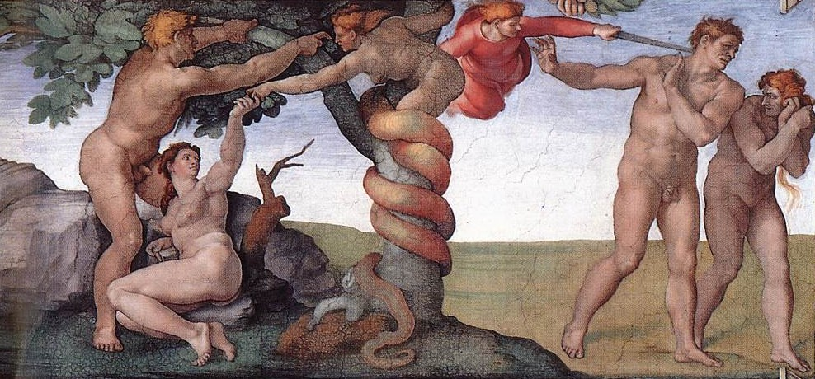
Misused freedom
Source: Michelangelo, Part of the Sistine Chapel Ceiling, Public domain
Genesis 3:17, 23-24, “And to Adam he said, "Because you have … eaten of the tree of which I commanded you, `You shall not eat of it,’ cursed is the ground because of you; … therefore the LORD God sent him forth from the garden of Eden, to till the ground from which he was taken. He drove out the man; and at the east of the garden of Eden he placed the cherubim, and a flaming sword which turned every way, to guard the way to the tree of life. ”

Slide 28
The need to put evil in context
While standards vary to some extent regarding what are the worst of crimes, at least some crimes in every culture are seen as horrific and “cry out” for punishment. Most punishments involve some kind of natural evil inflicted on the evildoer.
In the Bible, the failure of King David to punish his son Amnon for raping his half-sister triggered a civil war that nearly destroyed the kingdom (2 Samuel 13-18). David’s failure to administer natural evil (i.e. punishment) was seen as a great moral evil, generating even more moral and natural evil.
VERDICT. Natural evils often seem to be involved in solving the problems of great moral evils or achieving great goods … But Dostoyevsky, Dewi Zephaniah Phillips, and others have also argued that some evils are just too terrible to be justified by any instrumental benefits of eventual good outcomes.

Slide 29
The bigger picture: human flourishing?
Some aspects of flourishing are easy to identity, such as food and drink to sustain life. Others are more subtle, such as the capacity to exercise the mind, which also implies the need for good civic order, including safety and justice.
… but there are many examples of people who have been deprived of many of these goods and suffered many other kinds of evils. Yet these people have still been regarded as having led fruitful and even superlatively fruitful lives.
One can flourish as a person, even dramatically, despite not flourishing in terms of one health, education, opportunities, and social conditions. The possibilities for this flourishing are even greater from a perspective that assumes life after death.

Slide 30
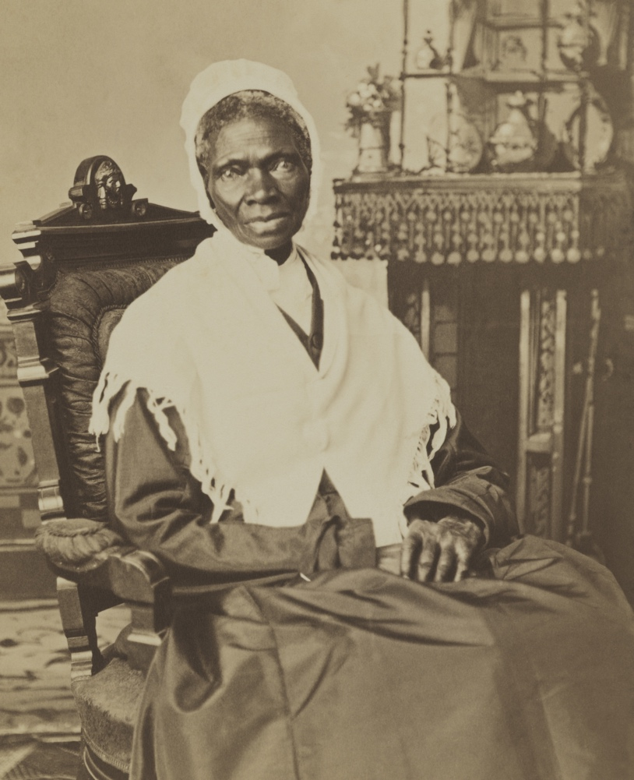
Greatness despite evil
Sojourner Truth (d. 1883) suffered tremendous disadvantages. She was born into and lived in slavery during her early life, during which she was often treated brutally.
When she finally gained freedom, she went to court and won the case to reclaim her son from slavery. She became famous as a campaigner for the abolition of slavery.
Today she is honoured as having lived one of the most significant lives in the history of the USA.
Source: A Wikimedia Commons version of an image in the public domain

Slide 31
The context of a Christian worldview
The use of evil to argue against God has often been done in Christian societies. So it is worth examining the broader context to see if Christianity can respond to these arguments.
Christianity brings many new factors into the context of arguments about evil, especially its central themes: that God became man, Jesus Christ, whom we as a species condemned to a shameful and tortuous means of public execution, namely death by scourging and crucifixion.
Christianity also teaches that Jesus Christ was resurrected from the dead, still bearing his wounds and calling us to follow him into a new life as adopted children of God.

Slide 32
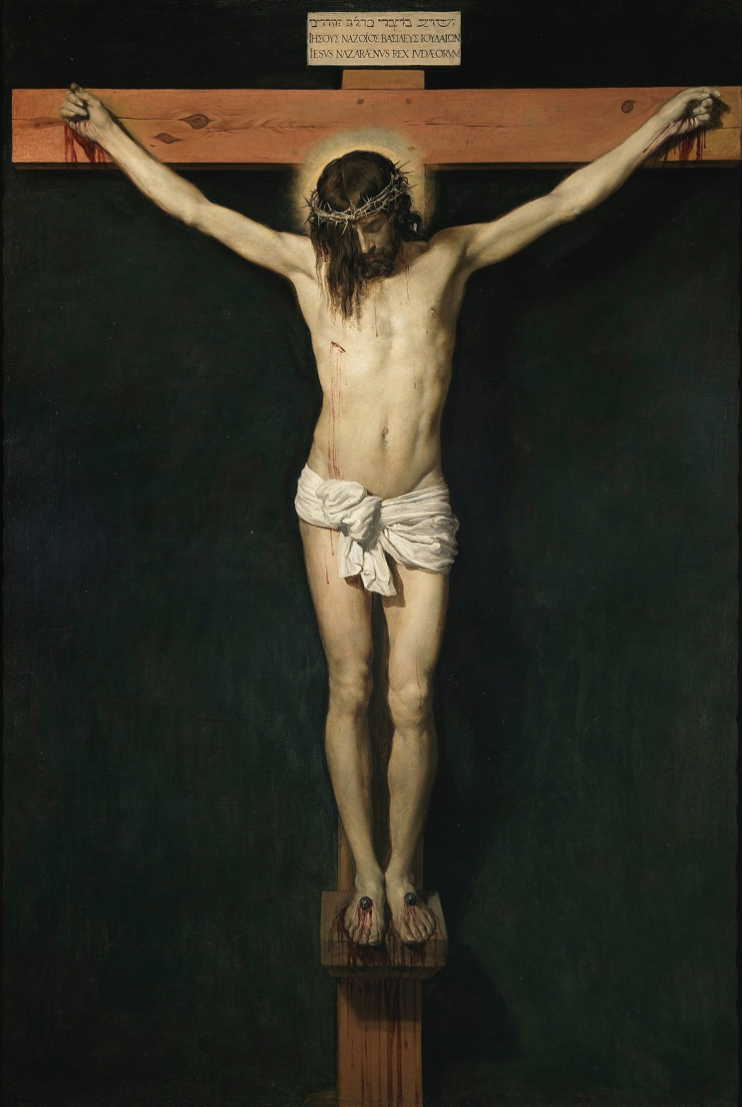
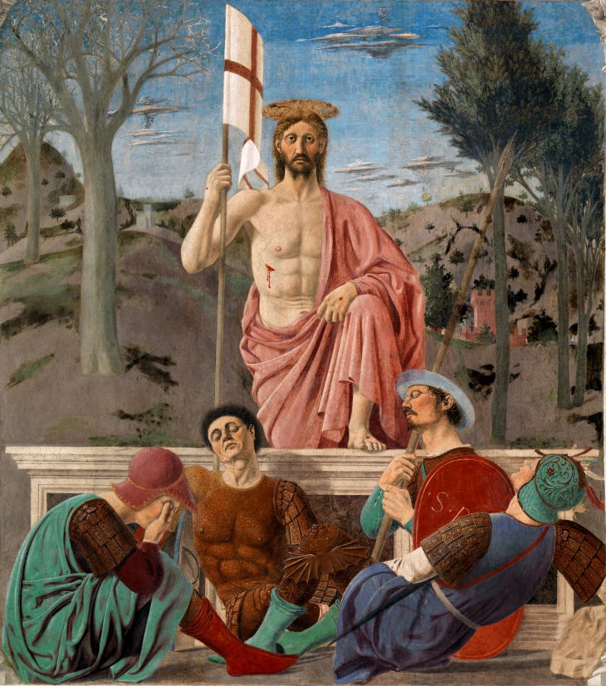
The death and resurrection of Jesus
Source: Christ Crucified by Diego Velázquez and The Resurrection of Christ by Piero della Francesca. Images in the public domains via Wikimedia Commons

Slide 33
Christianity and the resolution of evil
For Christianity, the heart of the issue is relationships, especially the relationship with God which is meant to be like a spiritual marriage. On this account, the worst evil is breaking this relationship, a spiritual adultery that is called sin.
God’s answer is to re-establish the relationship through Jesus Christ. This reunion restores our divine life as adopted children of God, and our sin is “hammered out” on the cross, removing our shame and guilt. This reunion, in which God incarnate bears the cost of sin, preserves our freedom. Each one of us can choose freely to accept or reject the relationship with Christ that heals our moral evils.
Christ’s Resurrection is also a sign that natural evils, including death, will finally be remedied by God in a new world free from evil (Revelation 21:1). Evil does not have the last word.

Slide 34
Conclusions

Slide 35
Concluding remarks
Evil is a deprivation of what is good. Natural evils are a metaphor and, at least in part, a consequence of moral evils.
The problem of evil that attracts most interest today is whether or not there is a morally sufficient reason for an all-powerful and all-knowing God to permit evil to exist.
Exploration of this issue highlights the role of free created beings in choosing evil and the way in which the endurance of natural evils can accompany personal greatness.
For the Judeo-Christian tradition, the most serious evil is sin, which damages or breaks the relationship with God. For Christianity, the restoration of this relationship, through Jesus Christ, heals the moral evil of sin. This healing also promises a future and final healing of natural evils in a new world.

Slide 36
Further reading and viewing
Short videos
Stephen Fry’s challenge on the problem of evil: https://www.youtube.com/watch?v=-suvkwNYSQo
Bishop Robert Barron’s response to Stephen Fry: https://www.youtube.com/watch?v=07AWWJiyAU8
The Problem of Evil: Crash Course Philosophy #13: https://www.youtube.com/watch?v=9AzNEG1GB-k
The Free Will Defence: A Good God vs The Problem of Evil: https://www.youtube.com/watch?v=qJYycge3eFc
Bibliography and further reading
James R. Beebe, “The Logical Problem of Evil,” in The Internet Encyclopedia of Philosophy, https://iep.utm.edu/evil-log/#
Stump, Eleonore, Wandering in Darkness: Narrative and the Problem of Suffering (Oxford University Press, 2012); Atonement (Oxford University Press, 2018)

Slide 37
“God will wipe away every tear from their eyes, and death shall be no more, neither shall there be mourning nor crying nor pain any more, for the former things have passed away.” (Revelation 21:4)
The Plains of Heaven by John Martin (Source: Tate Britain public domain; image released under Creative Commons CC-BY-NC-ND)

Slide 38
This publication was made possible through the support of a grant from Templeton World Charity Foundation, Inc. The opinions expressed in this publication are those of the authors and do not necessarily reflect the views of Templeton World Charity Foundation, Inc.

